Slide 1
Database Systems
Lecture 1-Chapter # 20
Introduction to Transaction Processing Concepts and Theory
Alina Arshad
alina.arshad@nu.edu.pk

Slide 2
Introduction
Transaction
Describes local unit of database processing
Transaction processing systems
Systems with large databases and hundreds of concurrent users
Require high availability and fast response time

Slide 3
Introduction to Transaction Processing
Single-user DBMS
At most one user at a time can use the system
Example: home computer
Multiuser DBMS
Many users can access the system (database) concurrently
Example: airline reservations system

Slide 4
Introduction to Transaction Processing (cont’d.)
Multiprogramming
Allows operating system to execute multiple processes concurrently
Executes commands from one process, then suspends that process and executes commands from another process, etc.

Slide 5
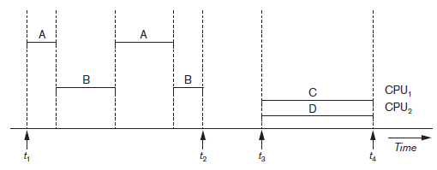
Introduction to Transaction Processing (cont’d.)
Interleaved processing
Parallel processing
Processes C and D in figure below
Figure 20.1 Interleaved processing versus parallel processing of concurrent transactions

Slide 6
Transactions
Transaction: an executing program
Forms logical unit of database processing
Begin and end transaction statements
Specify transaction boundaries
Read-only transaction
Read-write transaction

Slide 7
Database Items
Database represented as collection of named data items
Size of a data item called its granularity
Data item
Record
Disk block
Attribute value of a record
Transaction processing concepts independent of item granularity

Slide 8
Read and Write Operations
read_item(X)
Reads a database item named X into a program variable named X
Process includes finding the address of the disk block, and copying to and from a memory buffer
write_item(X)
Writes the value of program variable X into the database item named X
Process includes finding the address of the disk block, copying to and from a memory buffer, and storing the updated disk block back to disk

Slide 9
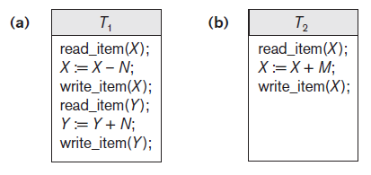
Read and Write Operations (cont’d.)
Read set of a transaction
Set of all items read
Write set of a transaction
Set of all items written
Figure 20.2 Two sample transactions (a) Transaction T1 (b) Transaction T2

Slide 10
DBMS Buffers
DBMS will maintain several main memory data buffers in the database cache
When buffers are occupied, a buffer replacement policy is used to choose which buffer will be replaced
Example policy: least recently used

Slide 11
Concurrency Control
Transactions submitted by various users may execute concurrently
Access and update the same database items
Some form of concurrency control is needed
The lost update problem
Occurs when two transactions that access the same database items have operations interleaved
Results in incorrect value of some database items

Slide 12
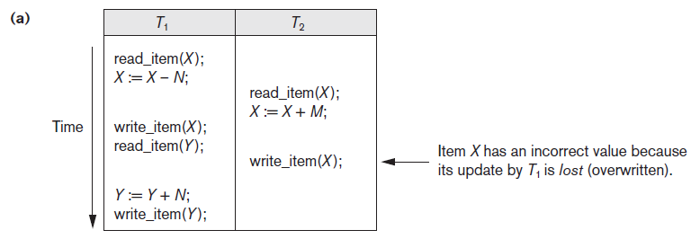
The Lost Update Problem
Figure 20.3 Some problems that occur when concurrent execution is uncontrolled (a) The lost update problem

Slide 13
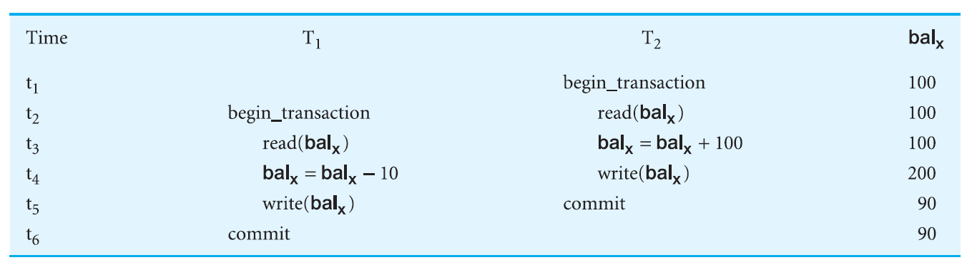
The Lost Update Problem
Figure 20.3 Some problems that occur when concurrent execution is uncontrolled (a) The lost update problem

Slide 14
The Lost Update Problem
The problem occurs when two different database transactions perform the read/write operations on the same database items in an interleaved manner (i.e., concurrent execution) that makes the values of the items incorrect hence making the database inconsistent.

Slide 15
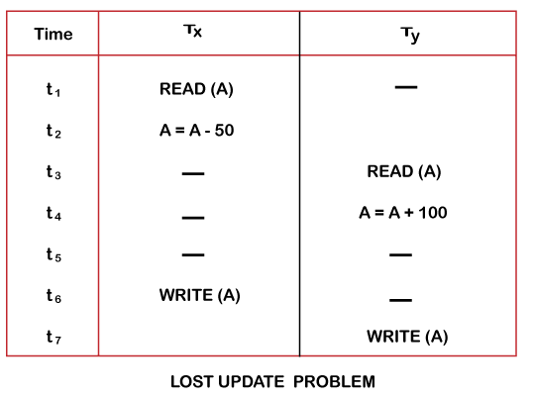
The Lost Update Problem
For example:
Consider the below diagram where two transactions TX and TY, are performed on the same account A where the balance of account A is $300.

Slide 16
The Lost Update Problem
At time t1, transaction T_{X} reads the value of account A, i.e., $300 (only read).
At time t2, transaction T_{X} deducts $50 from account A that becomes $250 (only deducted and not updated/write).
Alternately, at time t3, transaction T_{Y} reads the value of account A that will be $300 only because T_{X} didn't update the value yet.
At time t4, transaction T_{Y} adds $100 to account A that becomes $400 (only added but not updated/write).
At time t6, transaction T_{X} writes the value of account A that will be updated as $250 only, as T_{Y} didn't update the value yet.
Similarly, at time t7, transaction T_{Y} writes the values of account A, so it will write as done at time t4 that will be $400. It means the value written by T_{X} is lost, i.e., $250 is lost.

Slide 17
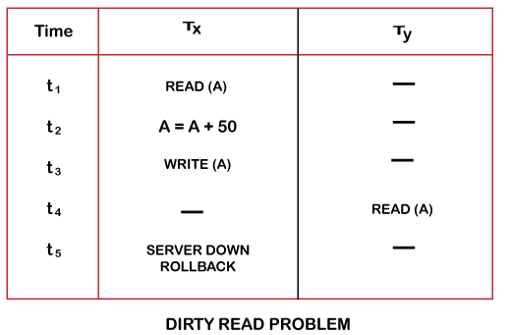
The Temporary Update Problem OR Dirty Read Problem OR Uncommitted Dependency Problem
The dirty read problem occurs when one transaction updates an item of the database, and somehow the transaction fails, and before the data gets rollback, the updated database item is accessed by another transaction. There comes the Read-Write Conflict between both transactions.
For example:
Consider two transactions T_{X} and T_{Y} in the below diagram performing read/write operations on account A where the available balance in account A is $300:

Slide 18
The Temporary Update Problem OR Dirty Read Problem OR Uncommitted Dependency Problem
At time t1, transaction T_{X} reads the value of account A, i.e., $300.
At time t2, transaction T_{X} adds $50 to account A that becomes $350.
At time t3, transaction T_{X} writes the updated value in account A, i.e., $350.
Then at time t4, transaction T_{Y} reads account A that will be read as $350.
Then at time t5, transaction T_{X} rollbacks due to server problem, and the value changes back to $300 (as initially).
But the value for account A remains $350 for transaction T_{Y} as committed, which is the dirty read and therefore known as the Dirty Read Problem.

Slide 19
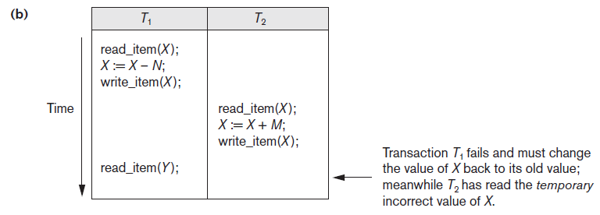
The Temporary Update Problem OR Dirty Read Problem OR Uncommitted Dependency Problem
Figure 20.3 (cont’d.) Some problems that occur when concurrent execution is uncontrolled (b) The temporary update problem

Slide 20
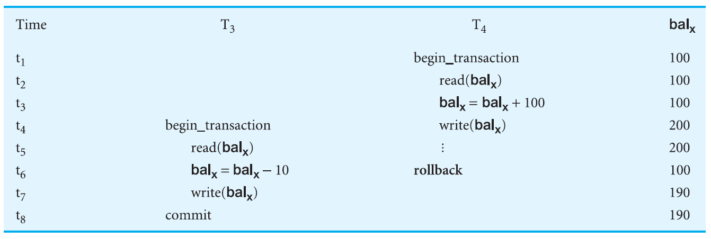
The Temporary Update Problem OR Dirty Read Problem OR Uncommitted Dependency Problem
Figure 20.3 (cont’d.) Some problems that occur when concurrent execution is uncontrolled (b) The temporary update problem

Slide 21
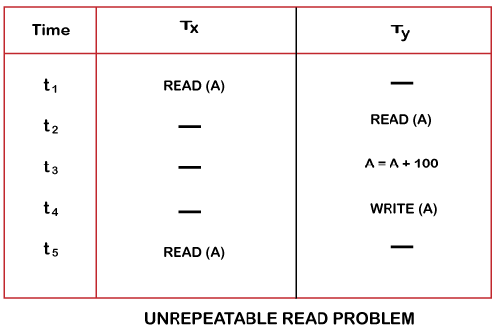
The Incorrect Summary Problem
Also known as Inconsistent Retrievals Problem that occurs when in a transaction, two different values are read for the same database item.
For example:
Consider two transactions, TX and TY, performing the read/write operations on account A, having an available balance = $300. The diagram is shown below:

Slide 22
The Incorrect Summary Problem
At time t1, transaction TX reads the value from account A, i.e., $300.
At time t2, transaction TY reads the value from account A, i.e., $300.
At time t3, transaction TY updates the value of account A by adding $100 to the available balance, and then it becomes $400.
At time t4, transaction TY writes the updated value, i.e., $400.
After that, at time t5, transaction TX reads the available value of account A, and that will be read as $400.
It means that within the same transaction TX, it reads two different values of account A, i.e., $ 300 initially, and after update made by transaction TY, it reads $400. It is an unrepeatable read and is therefore known as the Unrepeatable read problem.
Thus, in order to maintain consistency in the database and avoid such problems that take place in concurrent execution, management is needed, and that is where the concept of Concurrency Control comes into role.

Slide 23
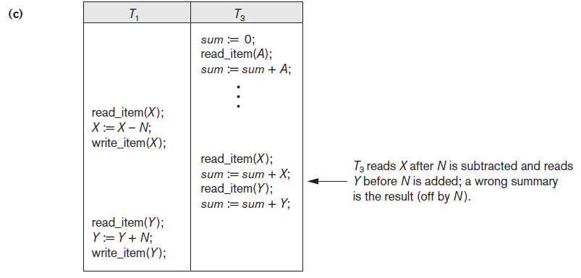
The Incorrect Summary Problem
Figure 20.3 (cont’d.) Some problems that occur when concurrent execution is uncontrolled (c) The incorrect summary problem

Slide 24
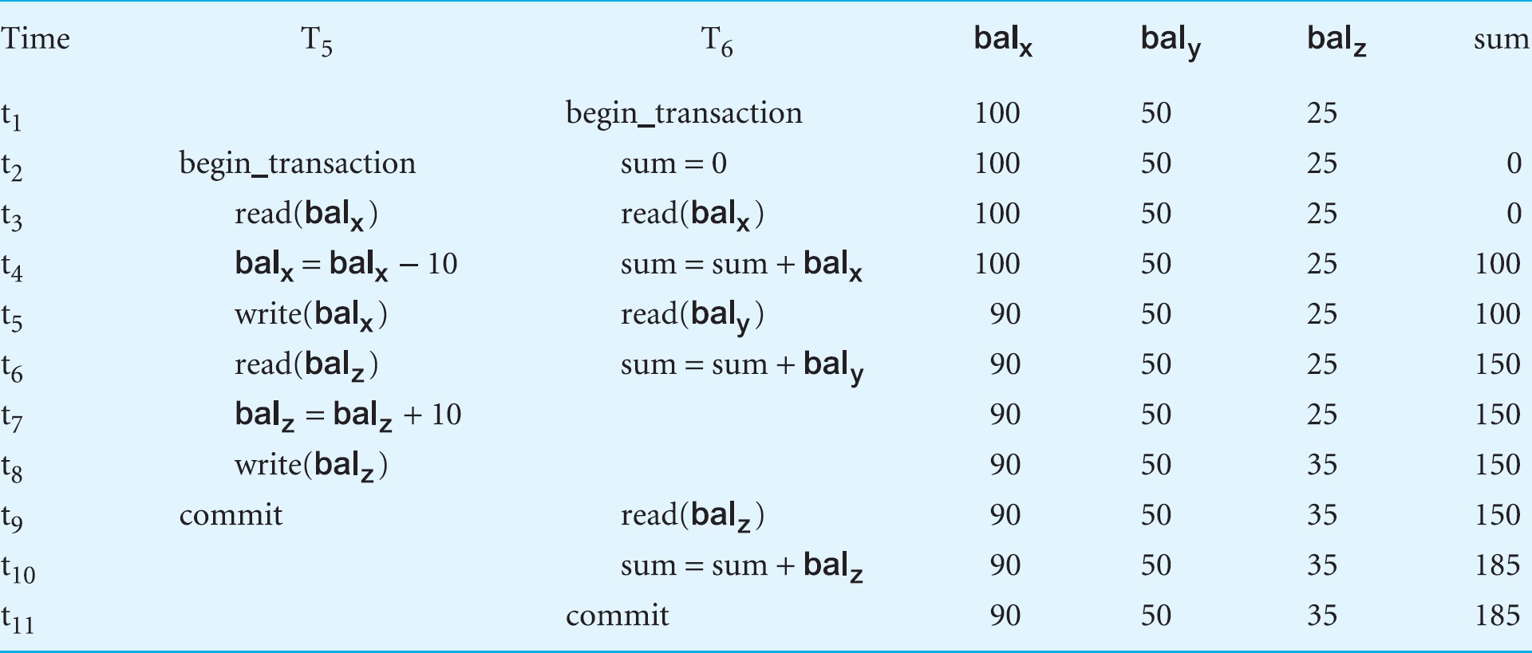
The Incorrect Summary Problem OR Inconsistent Analysis Problem
Figure 20.3 (cont’d.) Some problems that occur when concurrent execution is uncontrolled (c) The incorrect summary problem

Slide 25
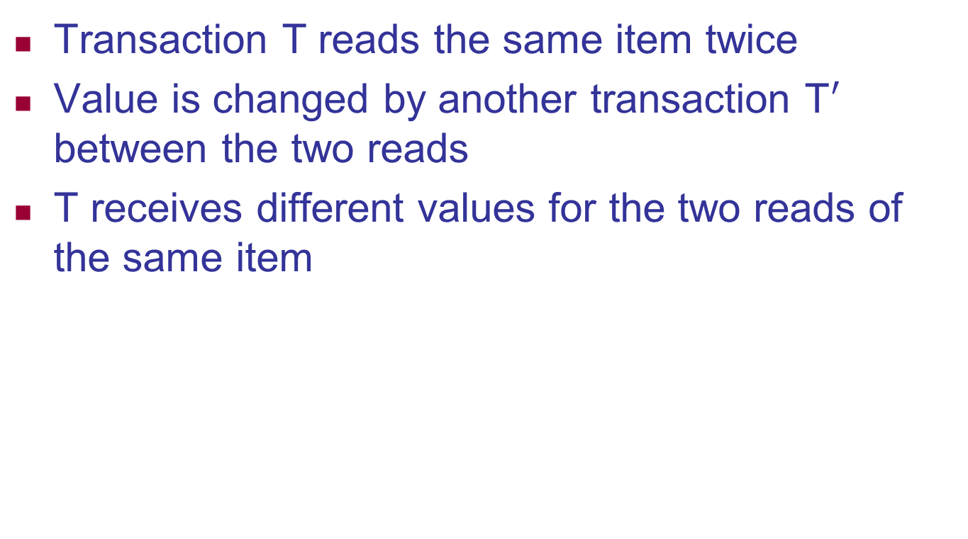
The Unrepeatable Read Problem (Fuzzy Read)

Slide 26
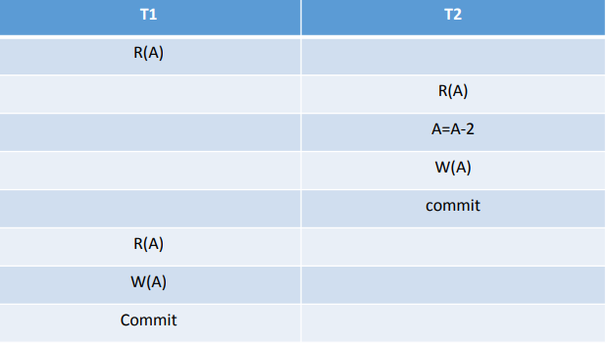

Slide 27
